Slide 1


Case Study Roni Asatourian

Slide 2
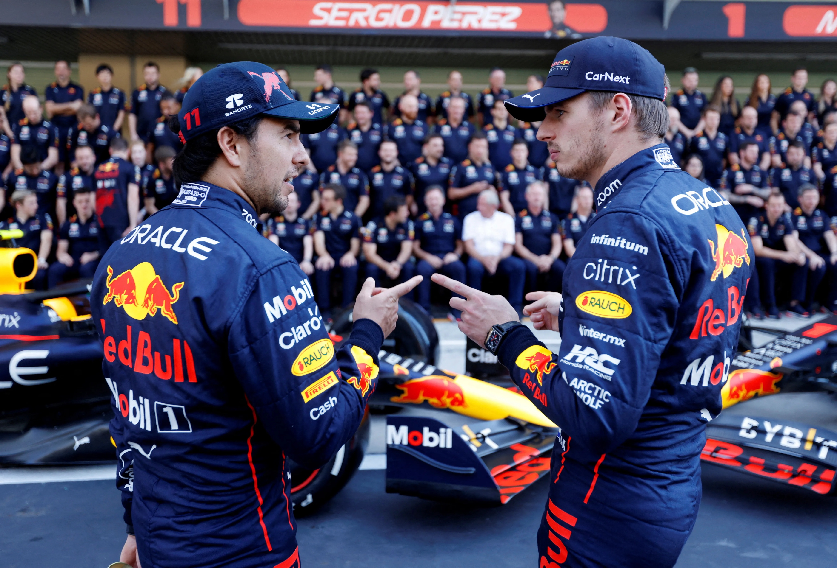
Introduction to Data Analysis for Red Bull F1
Utilizing Data in Formula 1 Racing
Purpose: Boosting Team and Driver Performance
through the power of Data Analysis
Analysis Approach: EDA, Regression, Forecasting
Expected Outcomes: Informed Decisions &
Enhanced Performance
Presentation Structure: From Data Exploration
to Strategic Insight

Slide 3
Data Architecture & tooling
Data Sources: Daily CSV Files
Data Processing: Python, Airflow
Data Warehousing: Google BigQuery
Visualization & Reporting: Tableau Dashboard
Data Model: Star Schema for Optimized Query performance
Fact Table: Race Performance Metrics
Dimension Tables: Driver, Team, Race Event, Venue, Season
Next Page for the Overall Overview

Slide 4
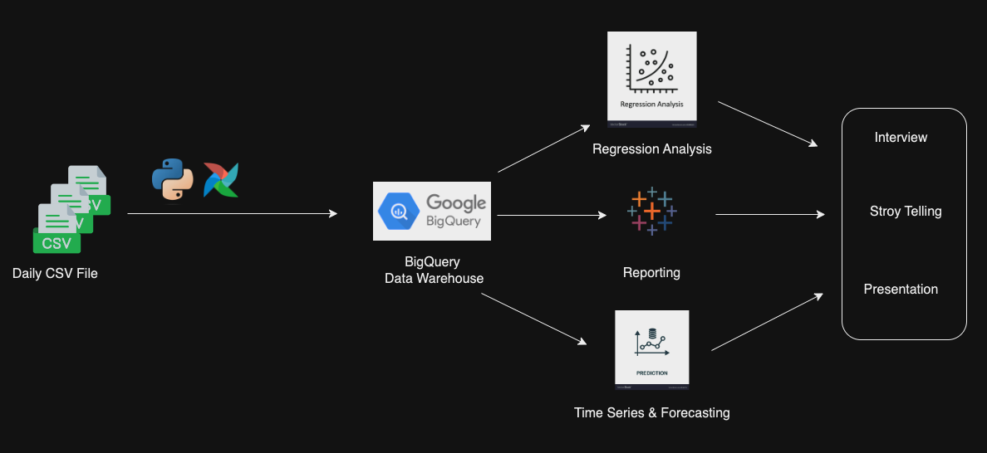
Data Architecture & tooling

Slide 5
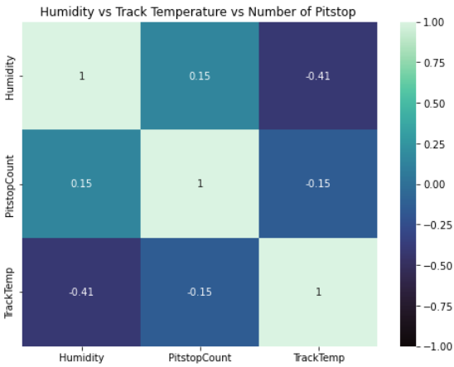
Key Findings from Exploratory Data Analysis
Lower humidity levels moderately correlate with higher pitstops.
Higher track temperatures moderately correlate with fewer pitstops.
Strategy focus may shift from weather conditions to other influential factors.
Recommend gathering tire wear data to strengthen our analysis and what can cause in higher pitstops.
More Tableau EDA: Team Driver Performance,
Team Performance

Slide 6
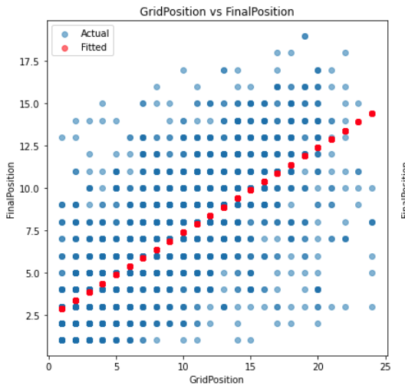
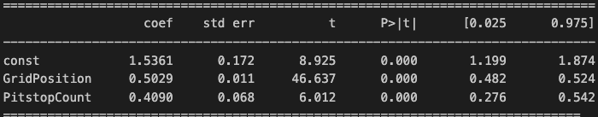
Regression Analysis and significant variables
Model Overview: Utilized Ordinary Least Squares (OLS) regression to identify determinants of race final positions.
R-squared Value: At 0.492, nearly 50% of the variability in final race positions can be explained by our model.
Significant Predictors:
Grid Position: Starting closer to the front significantly increases the chances of a better final position (p < 0.001).
Pit Stop Count: Fewer pit stops are associated with better final positions, highlighting the importance of race strategy and efficiency (p < 0.001).
Strategic Implications:
Qualifying Performance: Importance of qualifying rounds in securing a favorable starting grid position.
Pit Stop Strategy: Optimizing pit stop strategy to minimize time lost.
FinalPostion = 1.53 + (0.5 x GridPosition) + (0.4 x PitstopCount)
(H0): The starting grid position and the number of pit stops do not significantly influence the final race position.
(HA): The starting grid position and the number of pit stops significantly
influence the final race position.

Slide 7
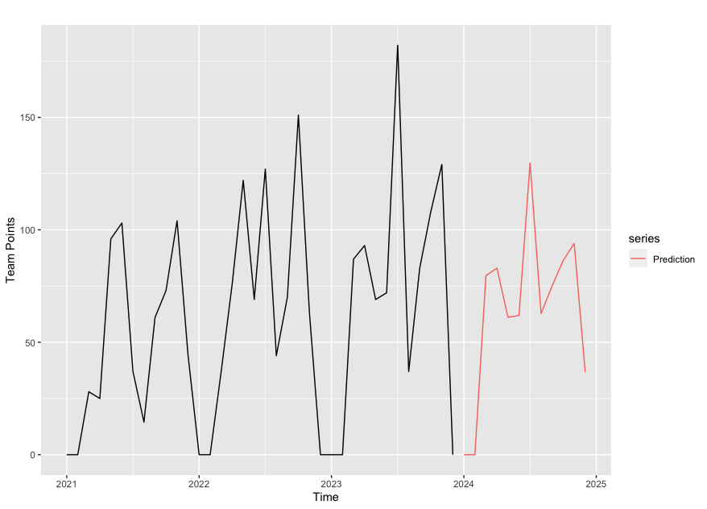
Forecasting 2024 Season trends
Continued Excellence: Forecast suggests Red Bull's F1 team is going to maintain its strong performance, building on its successful history.
Dominance in the Sport: The data points to Red Bull's continued prominence in the league, with a potential to outperform competitors.
Informed Strategy: Use of predictive analytics for planning resource allocation, marketing and sponsorship, driver training, and car development throughout the season.
Jan | Feb | Mar | Apr | May | Jun | Jul | Aug | Sep | Oct | Nov | Dec
0.0 | 0.0 | 79.6 | 82.9 | 61 | 61.9 | 129.7 | 62.7 | 75 | 86.2 | 86.2 | 36.6
Predicted Season Total Points: 770

Slide 8
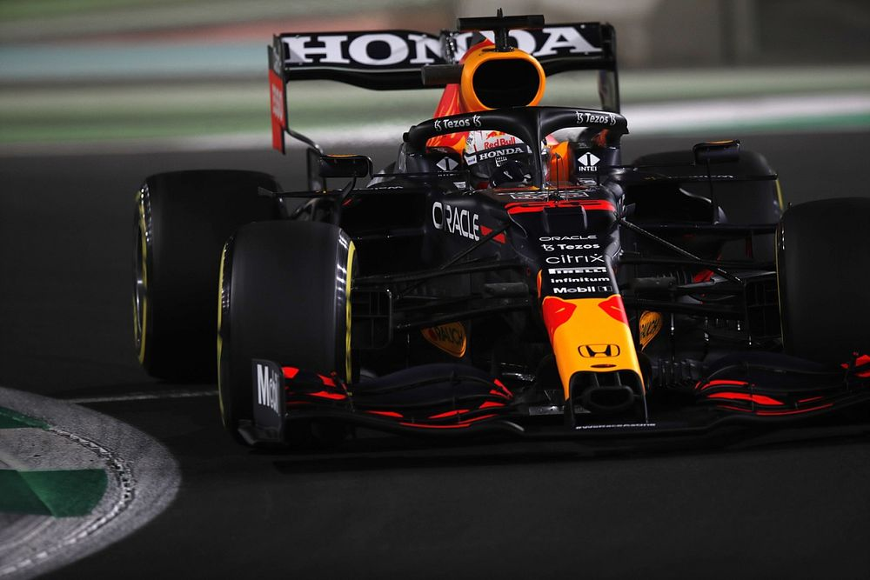




Business Insights and Recommendations
Optimization of Pit Stop Strategies:
Recommend strategies to minimize time lost during pit stops.
Driver Performance Analysis:
Compare the performance of drivers with competitors using advanced metrics.
Provide insights on areas for improvement in driver skills and strategies.
Risk Management in Uncertain Conditions:
Develop models to manage risks in uncertain race conditions (like weather changes).
Injury Prevention and Health Monitoring:
Implement data-driven approaches for monitoring driver health and fitness.
Enhancing Sponsorship and Marketing Efforts:
Analyze fan engagement data to improve marketing strategies.
Develop forecasting models to predict season outcomes to attract and negotiate with sponsors

Slide 9
Thank you
Project Link: Red-bull-F1-Case

